Slide 1




Electric Vehicle Charging Stations Global Network Review Capstone Project ~ Springboard: Introduction to Data Science Workshop
Credits:
Springboard, Mhairi McNeill (mentor), OpenChargeMap.org
July 3,2017

Slide 2
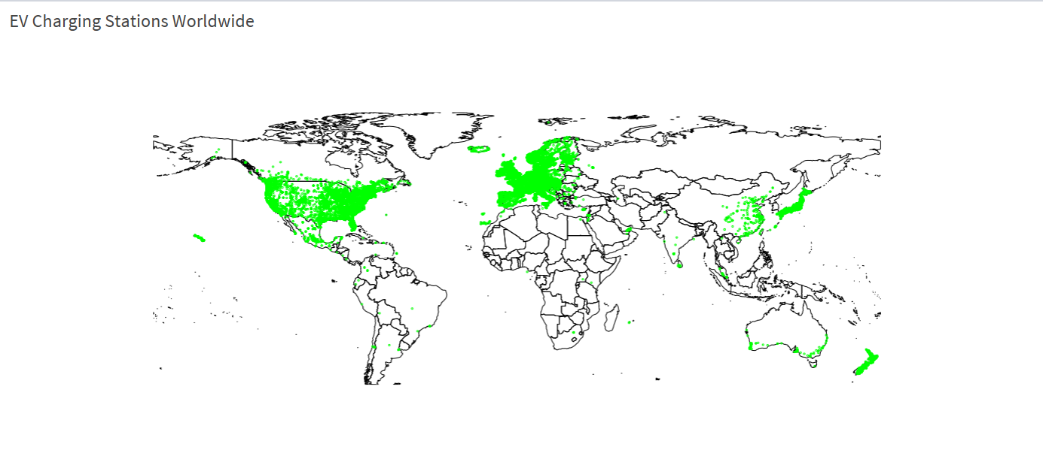
The Goal:
Design and provide interactive and user-friendly summary dashboard based on www.OpenChargeMap.org collected data.
Tell the story of the data through visualizations in RShiny.
The Client & Why Bother:
OpenChargeMap team (improve their own data; alternative for website viewer)
An electric vehicle user (alternative view of local/global data; increased data reliability)
A researcher, student, or any other user (learn/explore; improve)

Slide 3
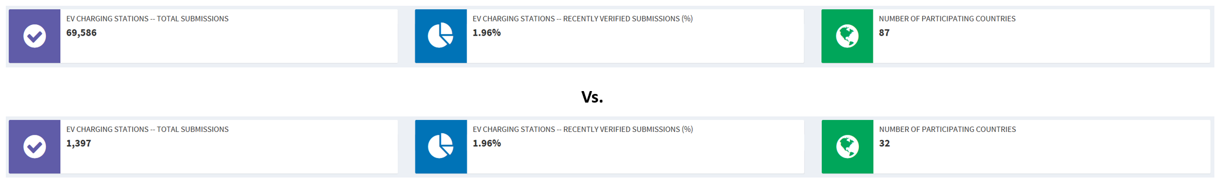
Opportunities:
Data collection:
Correct the 'country ID' coding: Corrected country ID list now available.
Improve updating the station validation status:
Currently, ~2% of ~70k entries marked as ‘recently validated’
Statistical analysis:
Option of including other data sources may introduce interesting opportunities for advanced statistical modelling
Additional data sources may include: population census data, proximity of stations to the highway systems, electric vehicle sales data, or alternative vehicle 'charging' stations (like natural gas or gasoline)
RShiny Dashboard:
Improve mapping
Alter ‘country IDs’ – add country names list dropdown

Slide 4



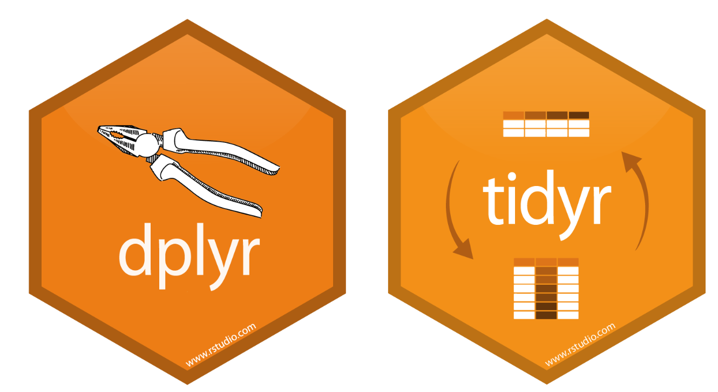
Data Set
Data set for the electric vehicles charging stations as published by the OpenChargeMap.com
Source: https://api.openchargemap.io/v2/poi/?output=json&maxresults=130000&compact=true&verbose=false
Data Wrangling
Data review, evaluation, and summary. Decided to keep 21 variables. Excluded all other variables.
Examples of data wrangling applied:
Mutated column names; changed N/A values to “0” values as needed (then excluded from visuals as needed); variable value replacement for 'UsageTypeID’, etc.
Data Visualization & Storytelling
Data formatting:
Summary dashboard boxes display expected summary data formatting (i.e comma in thousands, %).
I wire-framed the Shiny App look for the data, as I visualized it.
Made a 'prototype' in MS PowerBI.
Learned to use RShiny App to display the summary Dashboard for the complete data set and its subset.
Followed mentor’s advice

Slide 5
Exploratory Data Analysis Summary
Generally, weak relationships among most of the 21 variables in my final raw data
Due to the nature of the data, an interactive data visualization approach best to interpret the data set
RShiny App is the best environment for an interactive visualization of this data set
Interesting insights from this data set come from: timeseries, statistic summary, mapping/plotting
RShiny App is the best environment for an interactive visualization of this data set
Deliverables – Capstone Final Project
All on Github(https://github.com/stonka/Springboard-Capstone-Final-Electric-Vehicles-Shiny-Dashboard )
Final Code (generate data, Shiny dashboard)
Final Report
Final Slide Deck
ShinyApp Project link: https://tonkakozarovafenichel.shinyapps.io/Springboard_Capstone_CarDashboard_Final/

Slide 6
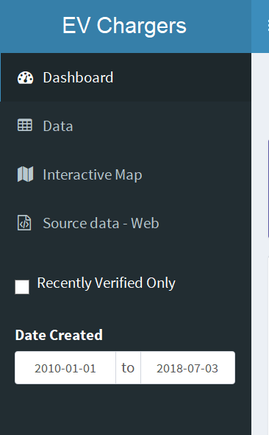
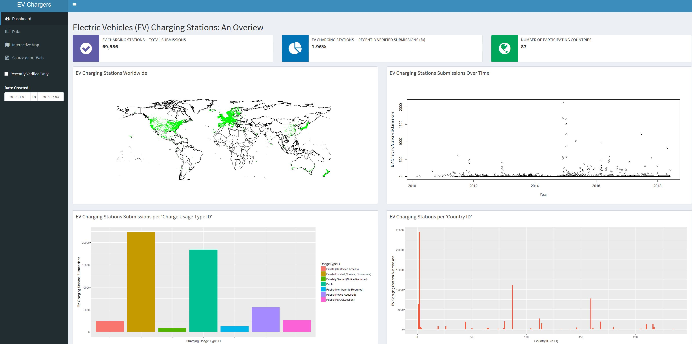
Outcome Summary: Dashboard

Slide 7
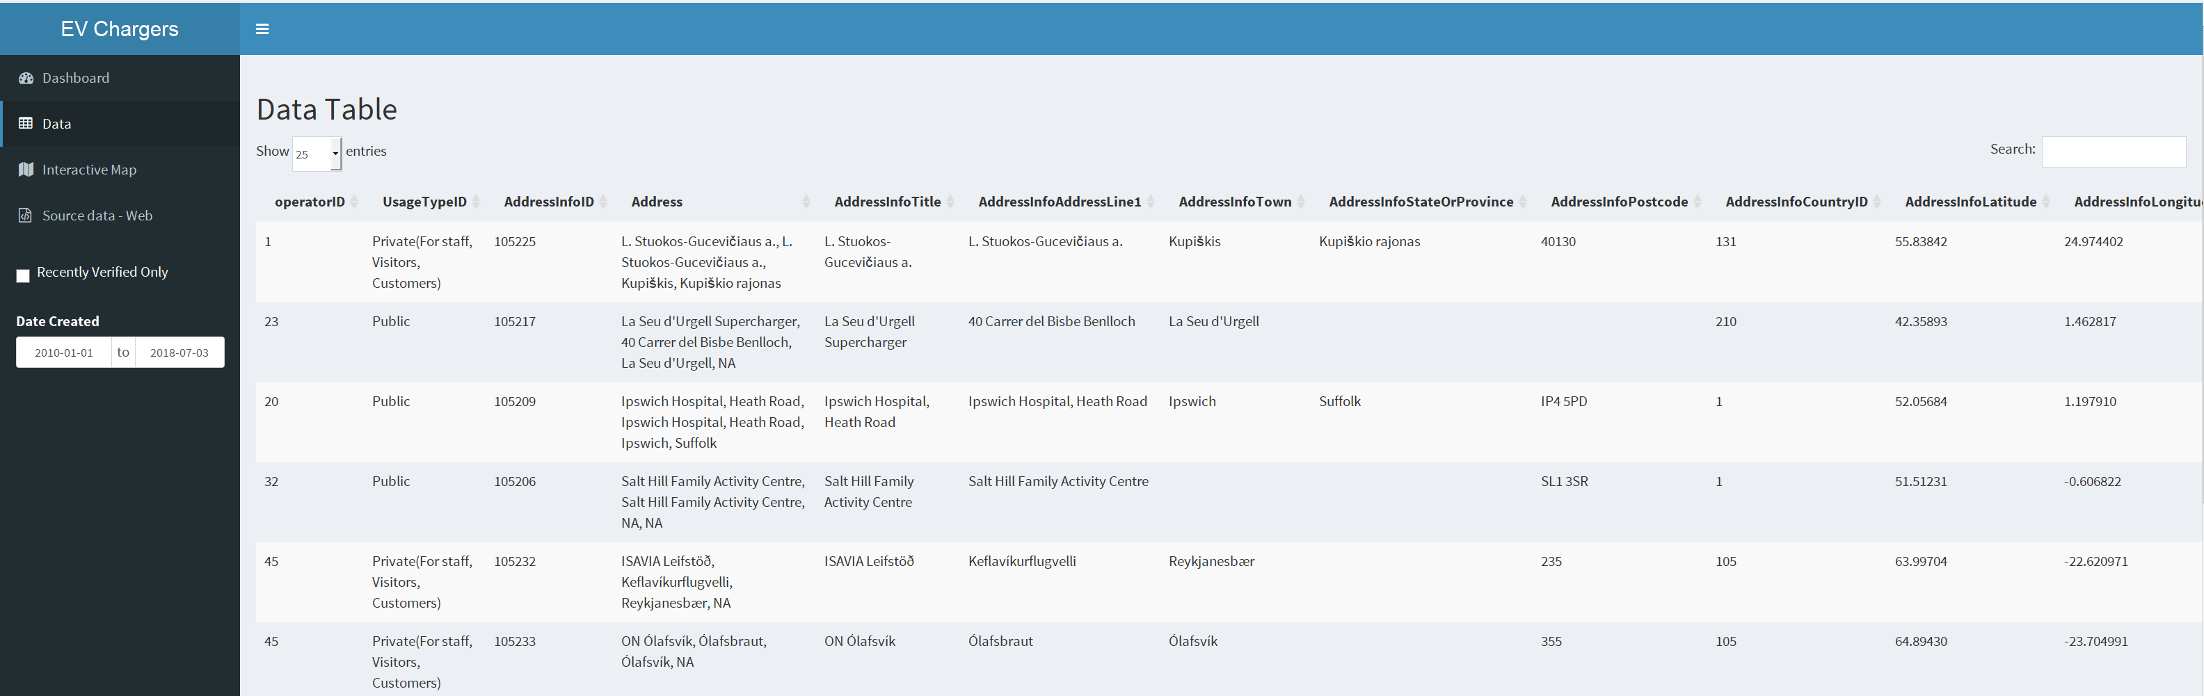
Outcome Summary: Data (Interactive Output)

Slide 8
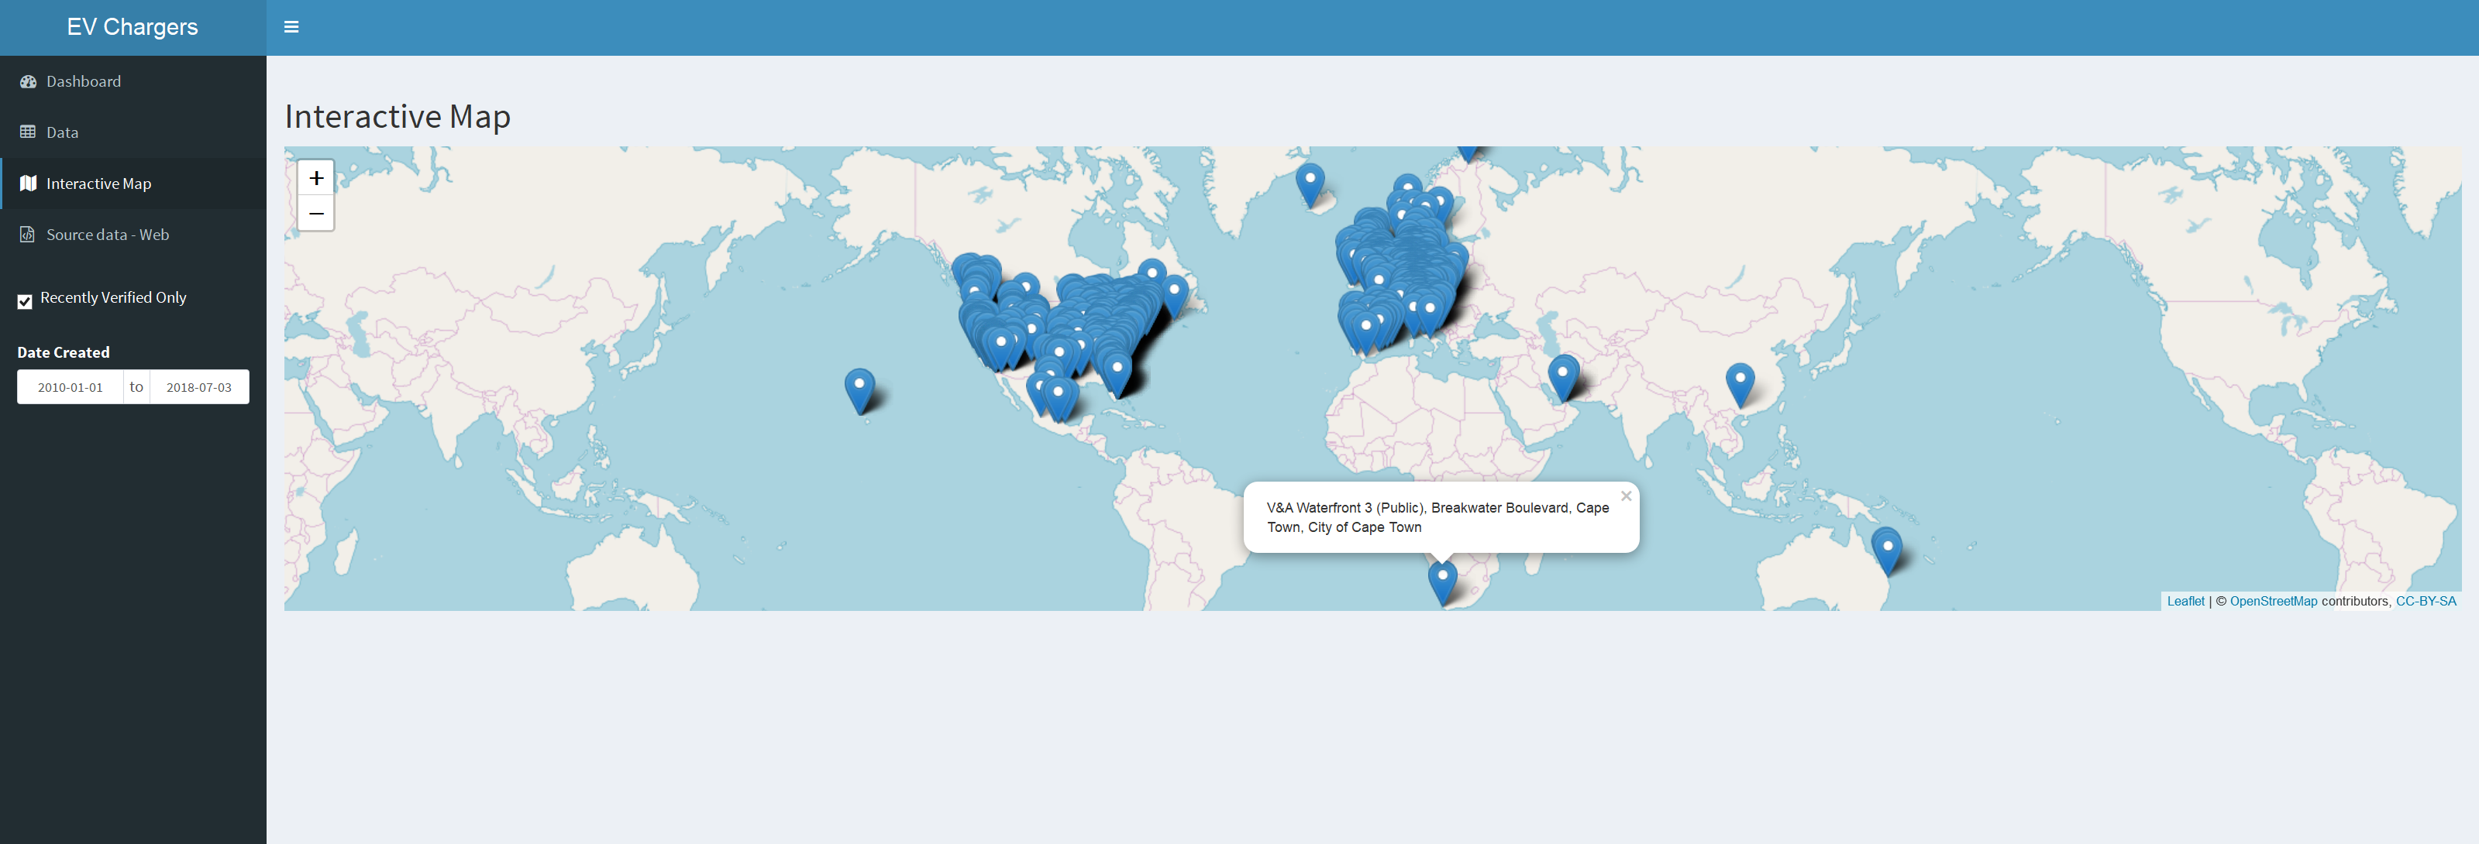
Outcome Summary: Map (Interactive Output)

Slide 9
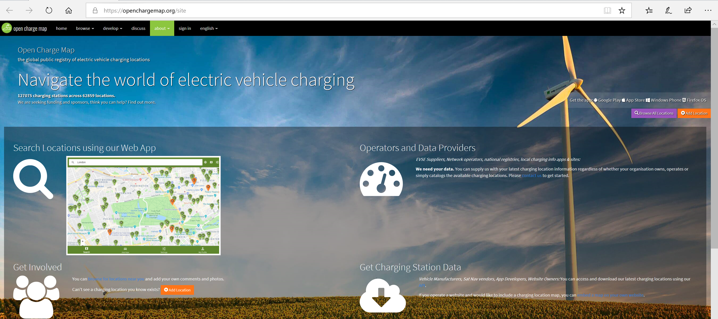
Outcome Summary: Data Source
https://openchargemap.org/site

Slide 10
Thank you & Questions

